Slide 1
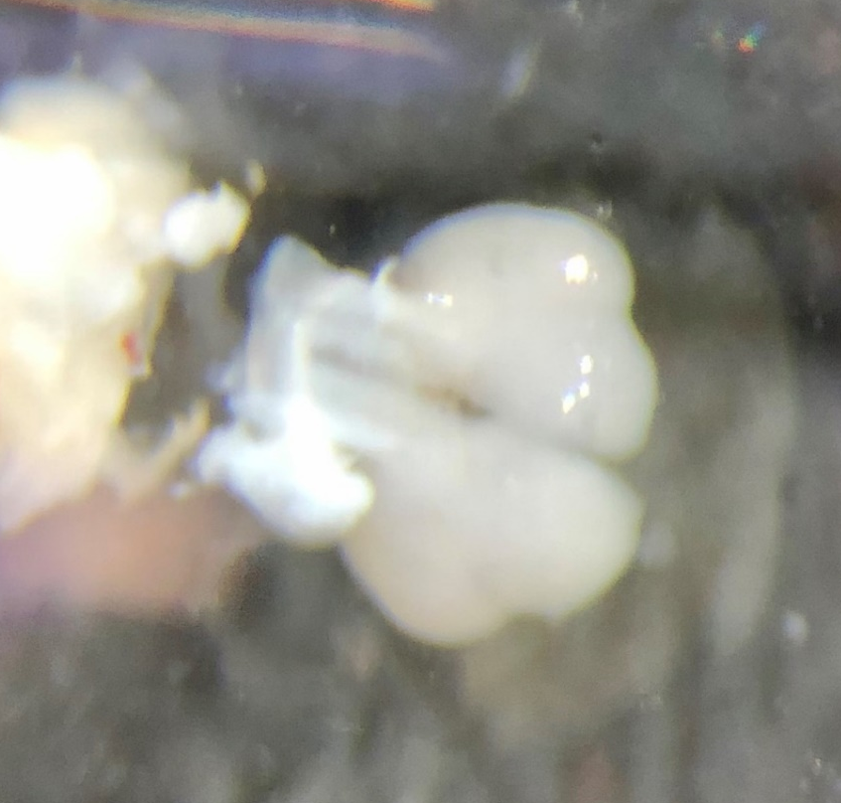
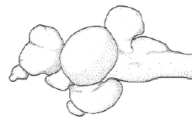
Removes excess telencephalon while preserving anterior POA
3
2
4
POA
1
POA
Blue dotted lines represent cuts made

Slide 2
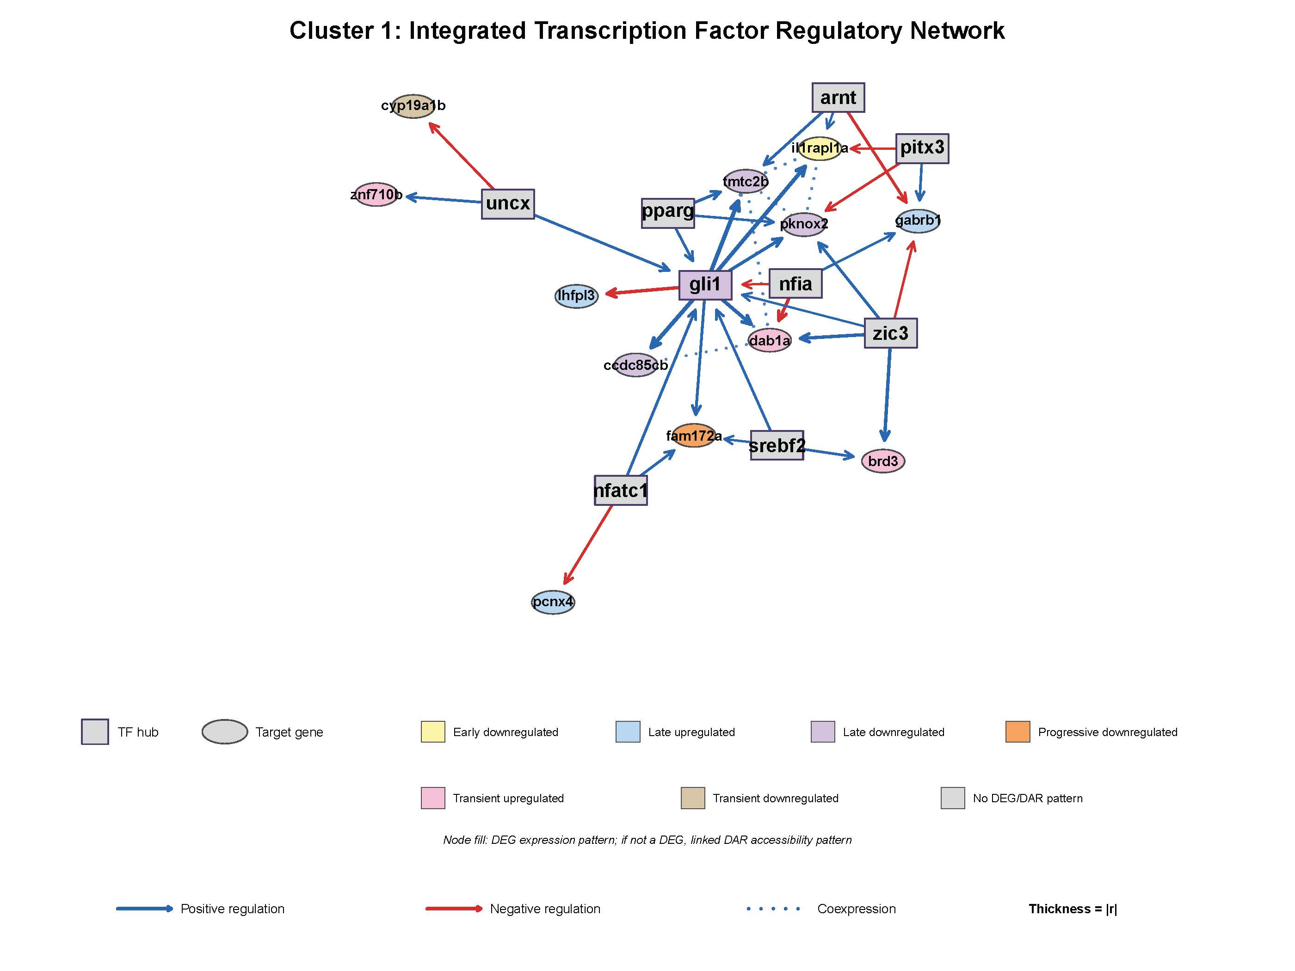

Slide 3
